Slide 1
Community pathway for managing respiratory tract infection/possible COVID-19/definite COVID-19 in Scottish NHS. Stage 3
Key points
This pathway must be considered as part of a whole system response, and will rely on teams working together.
Patients must be managed in the community where clinically possible
Secondary care should only be for clinically unwell patients , acute care should be available for advice regarding admissions.
Patients presenting with respiratory symptoms should be regarded as possible cases and should be managed in separate healthcare settings ( hub or designated practice) to those without respiratory illness until COVID-19 is excluded.
Risk of healthcare associated COVID-19 needs to recognised and should be minimised as much as possible
Existing ‘flu pandemic plans are likely to be helpful templates for clinical services to model new local pathways on.
Testing is likely to be overwhelmed in early weeks and will need to be focused according to clinical/organisational priority and follow national guidance
Telemedicine is a useful tool support to enhance and expand this should be considered a priority
The ability for secondary care to rapidly discharge all patients ( with clear plans) is essential to facilitate patient flow
HSCP community support and care requires to be robust to avoid delayed discharges or unnecessary admissions
Elective activity will require to be curtailed. Consideration should be given to enhanced healthcare support in community settings by shifting resources. e.g. To nursing homes and other community healthcare initiatives e.g. OPAT that would prevent admission to secondary care or facilitate rapid discharge.
Consideration should be given to what primary care can stop doing to free up capacity both in and out of hours
Critical care capacity is likely to be highly stretched. Up-skilling gen med physicians in HDU level care such as inotropic/NIV/HFNO may be of value in certain hospital settings.
Medical and nursing staff will need reassurance that the medico legal aspects of providing care out with the scope of their usual professional competencies and under extreme pressure are considered and they will be supported fully in any resulting safety/governance concerns that result from “doing the best they can” in extreme circumstances.
communication between primary care and secondary care needs to be robust both in the admission and discharge process.

Slide 2
National COVID-19/respiratory line NHS111
For possible concerned or known positive cases
New Breathless (MMRC 1+ *)
or
Risk factors § and fever or cough
Cough / fever
No co-morbidities
Local Hub
Primary care with senior decision maker
No breathlessness
Direct Primary care presentations-local pathways
Worsening advice, based on breathlessness
Self- isolate per current guidelines
Clinical Assessment
NB Key symptom is breathlessness
Clinical concern
Communication difficulties/ capacity concerns
If VC available, RR≥24
Complex COVID Severity Risk Factors
Yes, definite concern
No concerns
Yes, possible concern
Next day follow up if risk factors for deterioration*
Worsening advice if no co-morbidities. Follow self isolation guidance
Hospital
Assessment
Covid
Assessment Clinic

Slide 3
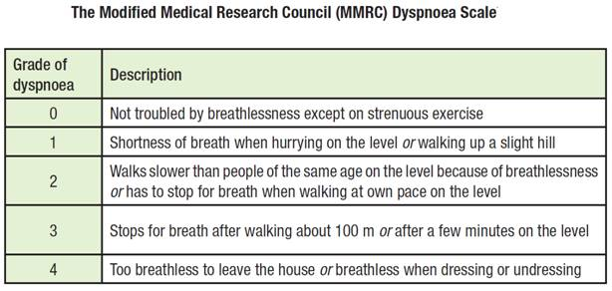
§ Risk Factors for deterioration
Age >60
Respiratory or cardiac comorbidities
Immunosuppression including cancer
Frailty
Diabetes
MMRC scale

Slide 4
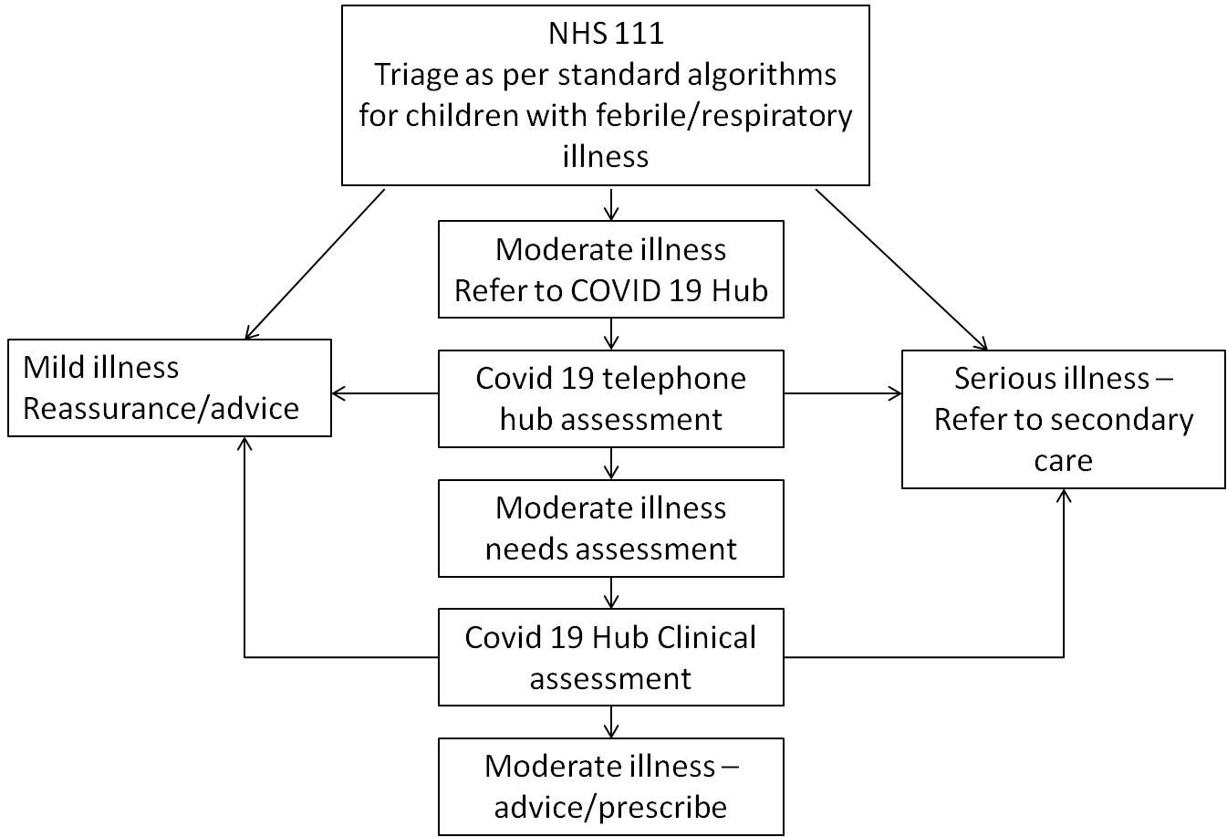
Paediatric pathway

Slide 5
Pathway for Pregnant Women
Central COVID-19 NHS24 – 111 help line
For pregnant women with respiratory symptoms at any stage of pregnancy
*Risk Factors for Deterioration
Respiratory or cardiac comorbidities
Immunosuppression
Diabetes (type 1&2 not gestational diabetes)
Cough/ Fever ,
no risk factors for deterioration*
Shortness of breath ,
Worsening respiratory symptoms OR
Risk factors for deterioration *
No breathlessness
Refer to secondary care –
telephone contact with
Maternity Triage, who will then advise according to:
Advise:-
Self isolate 7 days and inform primary midwife
Call back if worsening symptoms or develop breathlessness
No additional obstetric complications – follow local health board policy for admission
Additional obstetric complications – admit to obstetric unit

Slide 6
Maternity Pathway from primary MW
Risk Factors for Deterioration
Respiratory or cardiac comorbidities
Immunosuppression
Diabetes (type 1&2 not gestational)
Woman presents as symptomatic to primary MW
In labour?
Yes
No
Refer for combined assessment with obstetrician and physician in obstetric facility with isolation facility
Central COVID-19 NHS24 – 111 help line
For pregnant women with respiratory symptoms at any stage of pregnancy

Slide 7
HUB
Primary care HUB staffed by senior clinical decision maker e.g. GP , consultant or band 8 nurse staff should be drawn from across the system
Consider staff who may be advised to be non direct patient facing
Will accept calls triaged initially by NHS 24 and other primary care providers
Telemedicine centre ideally with access to video consultation e.g. Attend anywhere
No patient facing role
Will have access to local primary care records EMIS and Vision (where possible) and clinical portal
Must have access to ADASTRA
Will have a robust way to communicate with secondary care/SAS and COVID assessment clinic
Has protocols for worsening advice

Slide 8
COVID Assessment Clinic
Has ability to perform face to face assessments and take basic obs/NEWS/PEWS score
Able to discharge patients back to community with some access to therapeutic options/prescribing
1 administrator
3 nurses (1 front door, 2 assessing/buddying)
1 senior decision maker* ideally with prescribing ability
1 full time domestic
PPE (given likely to be high volume of COVID + should be resp PPE despite some cases being possible)
Obs kit (temp / sats probe / BP)
Testing kits
?limited medication to supply (asthma / LRTI)
?access to O2
IT infrastructure and needs to have links to vision/EMIS- GP record, with priority 1 coding also available on ECS
*See slide 7

Slide 9
Patient criteria for ambulatory care
Patient with borderline symptoms who would benefit from face to face clinical assessment
Communication difficulties - Learning difficulties / Capacity issues / Language barriers
Patients with complex COVID severity risk factors as identified in local hub but clinically well
Those assessed by HUB as benefiting from NEWS score to support triaging decision
Require to be able to attend the centre e.g. Mobility/transport considerations including ability to drive themselves and parking.

Slide 10
Flow
Patient arrives
(by appointment)
Waiting Room
Waiting room must have capacity to keep ?2-4 patients >2 metres apart
Surgical Mask put on patient by staff in PPE *
Obs taken
(+/-Swabs )
Triage Room
This needs cleaned between each patient
Senior decision maker** review
Consider admission if
Sats<92% (if COPD, patients known baseline or <88%)
RR≥24, increased work of breathing, NEWS >2
Other clinical concerns
Where possible additional community care services that may avoid admission should be utilised. E.G community respiratory nursing and elderly care hospital at home
Home
*following HPS guidance
**see slide 11

Slide 11
Site location
Acute site
Pros
Can provide fuller work up if required (XRay / bloods / ...)
Can provide COPD and other standard treatments if required
Maybe able to use unused elective are(e.g. OP facility)
Cons
Increased stress on acute site
Expectation this is the responsibility of secondary care physicians
Increased tendency to admit?
May be more remote from population in some cases
May not be suitable for rural settings
Community
Pros
Keeps patients away from acute site
Easier parking
Closer to the population
Reduced media/ public interest
Cons
Limited access to other Rxs / investigations
Requirement for potential further SAS transport if admitted to secondary care

Slide 12
Potential Senior Decision Makers
Respiratory clinicians
Respiratory CNSs (Primary and Secondary Care)
TB nurses
ED Band 6+ nurses
Acute medical / ED doctors
GPs
ANPs
(Paediatric assessor if co-located with paeds pathway)

Slide 13
Secondary Care Interface with primary care/HUB/COVID assessment clinic
Admission organisation
Senior Coordinator (ideally Band 7 SCN)
Coordinate admissions
Coordination of bed / flow of ?COVID /known COVID + patient assessment unit (minimise time in waiting room)
Stagger attendances with clinical prioritisation
Liaise with Hub / Ambulatory Testing Centre / Primary Care
Administrative support

Slide 14
Broader consideration for secondary care
Patient flow and discharge
Key principles
Patient flow out of secondary care is essential to allow rapid and high quality care of all admitted patients including those with possible or proven COVID-19
Patients with COVID-19, possible or +, can be discharged based on clinical grounds and do not need to wait for a negative COVID test x2 as per current guidelines
Discharge planning must be given the highest priority
HSCP need to have the ability to rapidly provide care in community settings to facilitate discharge
Patients may need to be moved to “downstream settings” in other facilities regardless of their postcode to facilitate bed availability at “front door”
Redeployment of staff from areas where elective work has stopped may be required, including to support rapid discharge arrangements
Where possible services that support community delivery of secondary care should be enhanced e.g. OPAT/respiratory and COPD nurse led services, hospital in the home etc.
Consider utilising other staff if that service is suspended.
Hospital pharmacy services must operate a 7 day a week service to support daily discharges throughout the day
Twice daily senior ward rounds would be expected 7 days a week to allow immediate discharges.
Consider use of nurse led discharge planning

Slide 15
Discharge criteria for a patient with known or possible COVID-19
No risk factors or co-morbidites
Ability to isolate(self isolate or family isolation)
Clinical improvement
NEWS<2
Discharge with worsening advice and contact information for outstanding results
Risk factors§
Ability to isolate(self isolate or family isolation)
Clinical improvement
NEWS <2
In patients with COPD
O2 sats at base line or >88% on Room air
Stable on discharge medication (i.e. If acute nebuliser started then off nebs for 24 hours)
Or home with resp nurse support where available for + patients
Or home after specialist respiratory advice
No additional clinical concerns
Discharge with worsening advice and contact information for outstanding results

